Slide 1


SMART INVENTORY &
SUPPLY CHAIN
MANAGEMENT
Presentation By:
Presentation To:
Rumit Hasan Foysal - 41230301764
Akash Ahmed - 41230301749
Istiak Ahmed - 41230301729
Sadia Farjana Mitu - 41230301727
Tasfia Tabassum Faija
Lecturer of CSE
Northern University Bangladesh

Slide 2



Smart Inventory & Supply Chain Management System
The Smart Inventory & Supply Chain Management System streamlines stock control and supply processes by ensuring accurate tracking, reducing costs, and improving efficiency for timely product delivery.

Slide 3


Problem & Soulation
Challenges in Traditional Inventory Management
Manual stock tracking → Phone to errors, mismatched records, and slow decision-making.
Lack of transparency → Difficult to monitor inbound and outbound shipments effectively.
Poor reporting → Managers miss timely insights for decision-making.

Slide 4

Problem & Soulation
Our Solution
Automated logs → Inbound and outbound stock tracking with accuracy.
Integration → Suppliers and shipments connected for better transparency.
Real-time insights → Queries and triggers provide up-to-date reports.
Improved reliability → System ensures professionalism compared to manual methods

Slide 5

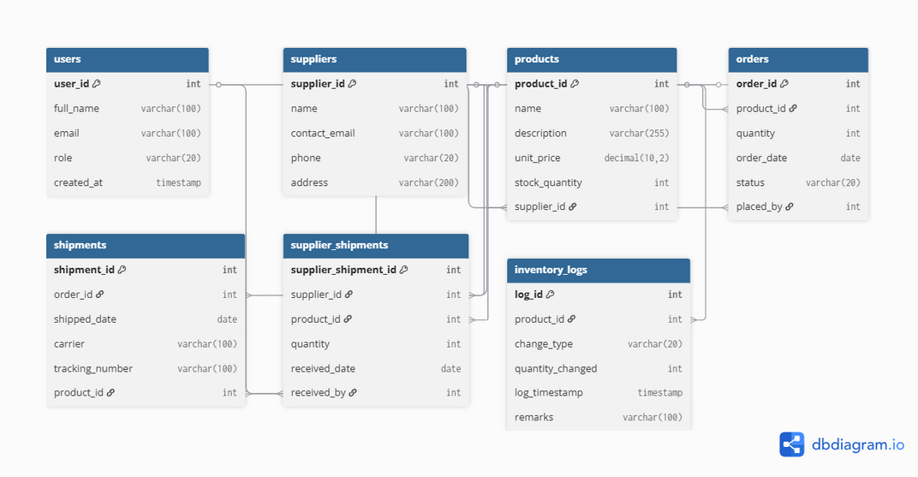
Database Desig Overview
Key Tables
Users, Suppliers, Products, order, Shipments, Supplier_Shipments, Inventory_Logs
Some important relationships include:
Users - Orders
Products - Suppliers
Orders - Shipments
Inventory logs track every change
Why its professional: normalized, scalable, enforces integrity

Slide 6



Advanced Database Features
View - Example: product_stock_view (combines product + supplier info)
Triggers - Auto update stock levels when inbound / outbound happens.
Procedures - Place_order, receive_shipment for business automation.
Constraints & Keys - Ensure data integrity.

Slide 7
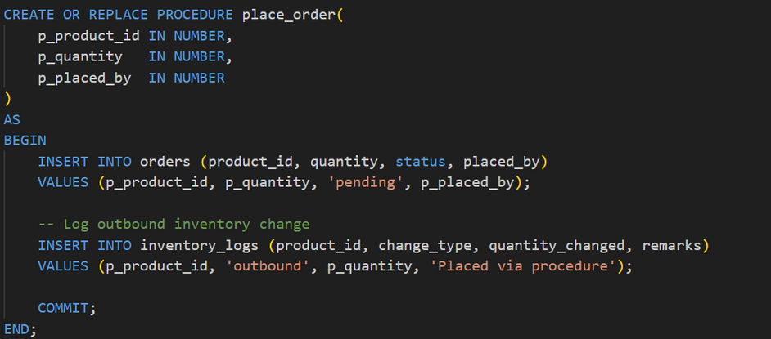
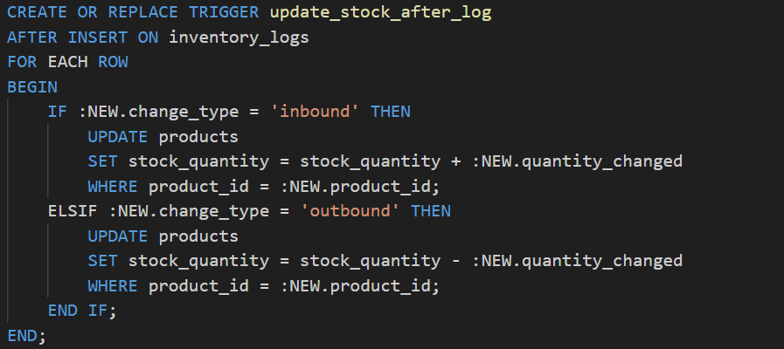
Oueries Demonstration
JOIN example (LEFT OUTER, NATRUAL)
Procedure execution (Exec place_order (3,5,2))
Trigger exection & auto stock updates.
SQLcl - “We even enabled JSON outputs to prove adaptability whith modern apps.”
“This is how real systems operate under the hood.”

Slide 8
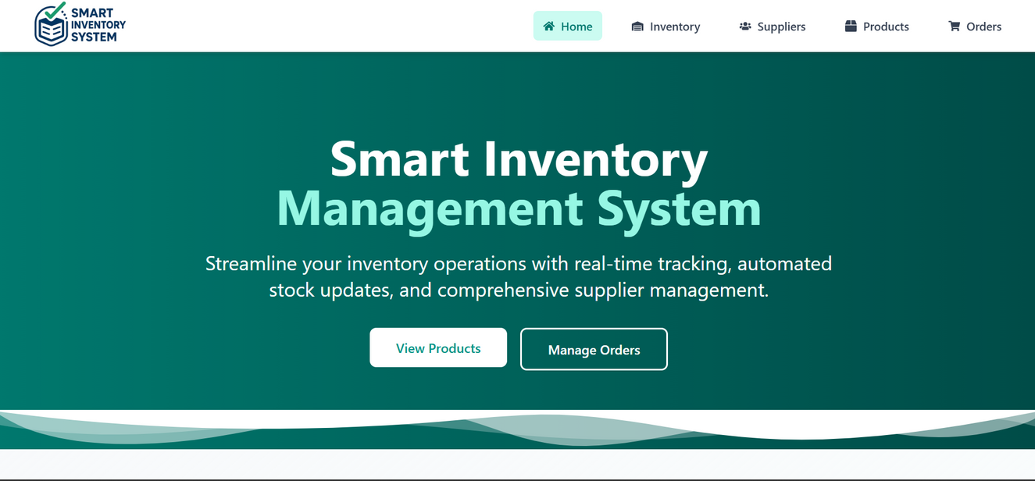

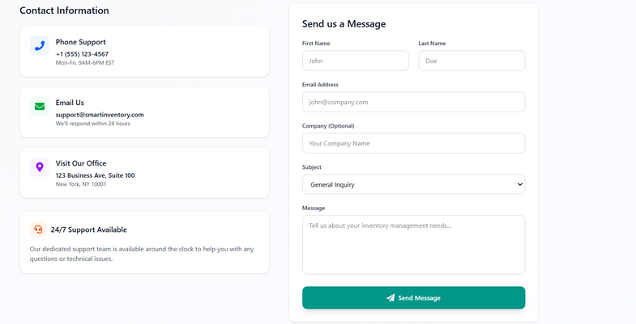
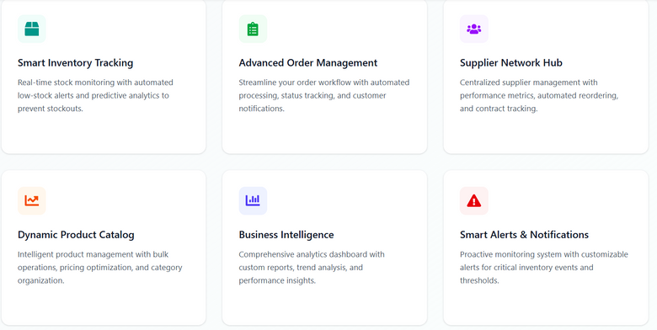
Frontend Showcase
Home

Slide 9
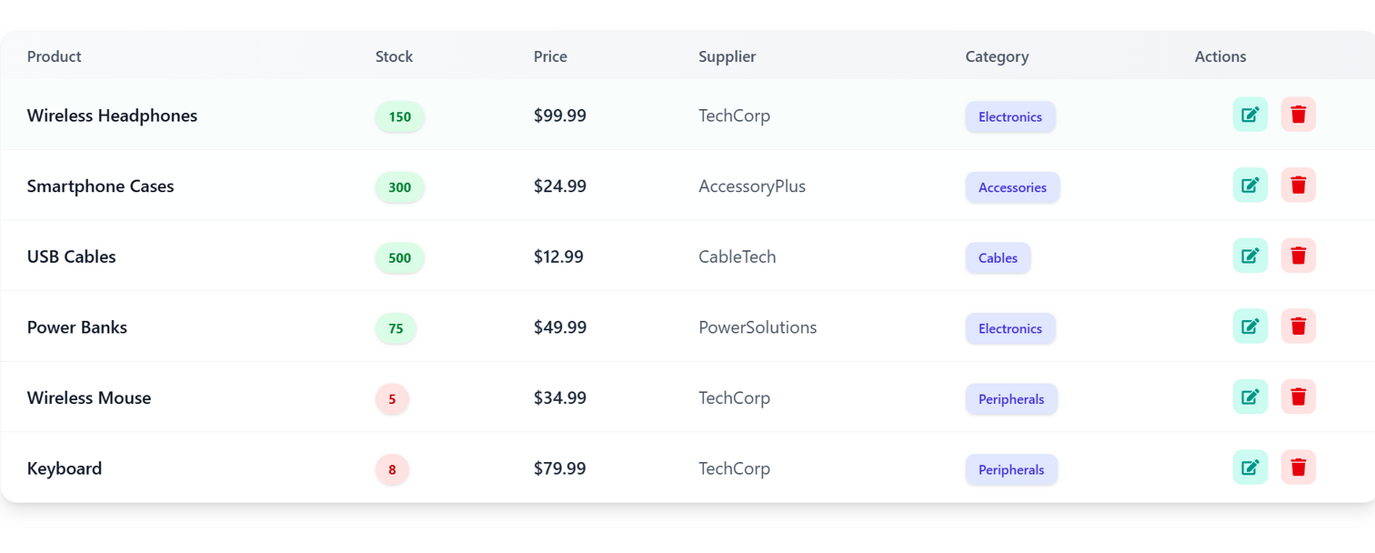
Frontend Showcase
Product list

Slide 10
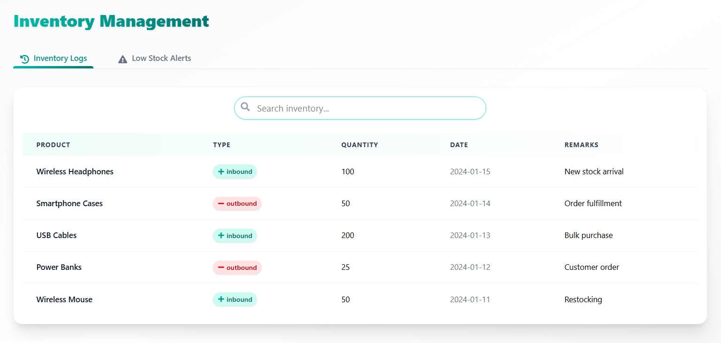
Frontend Showcase
Inventory Management

Slide 11
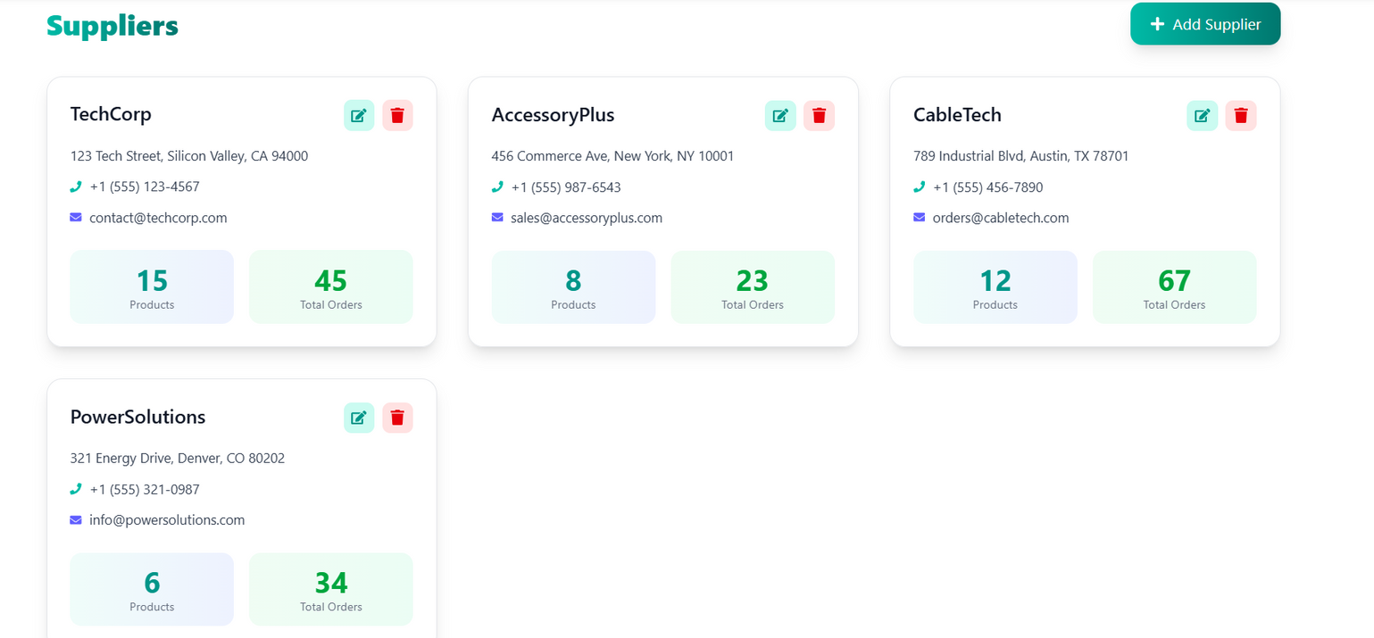
Frontend Showcase
Supplier info

Slide 12
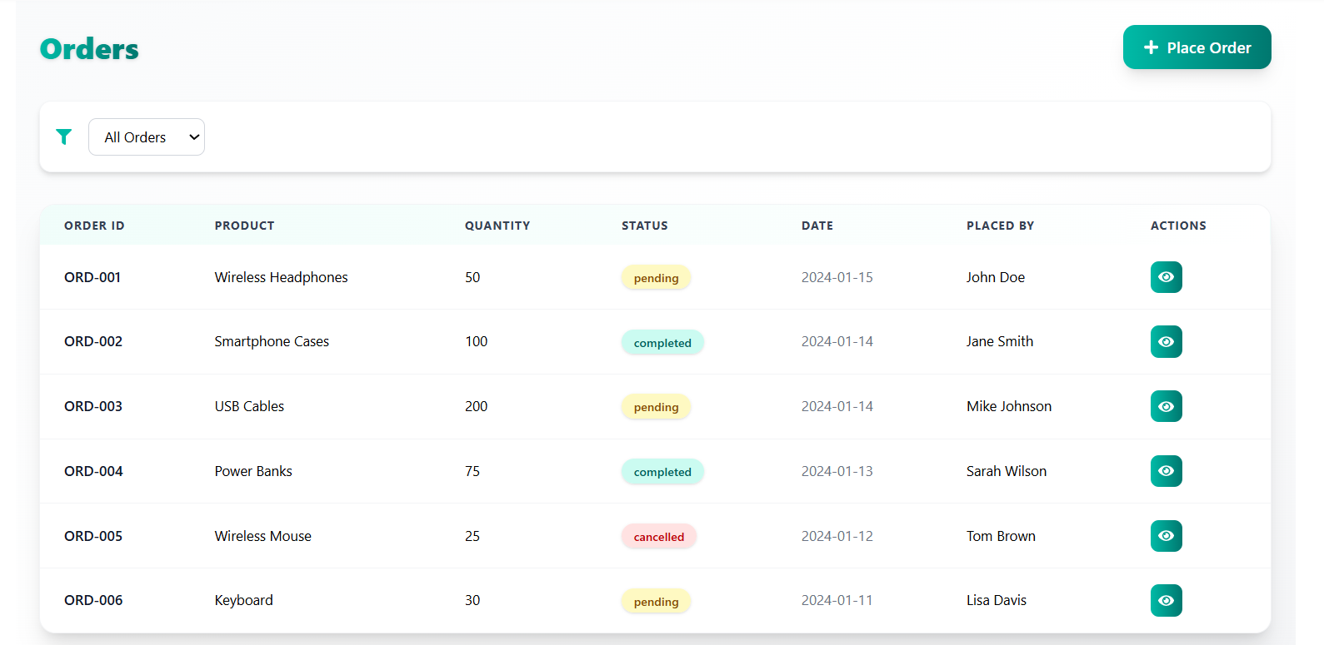
Frontend Showcase
Orders

Slide 13
Innovation & Professionalism
Uniqueness: Combined inbound & outbound shipment handling, automated logs, error prevention.
Scalability: Structure support future integration (e.g. analytics, REST APIs)
Industry relevance: Inventory + supply chain is a real world problem every business faces.
Highlight: “We designed it like an actual enterprise-grade system not just a student project.”

Slide 14

Add analytics & forecasting using historical data
Integration with cloud (Oracle APEX or Node.js backend)
Feature Scope
Role based dashboards (admin, staff)
Mobile friendly interfaces

Slide 15







Conclusion
Q&A
Our system already work like a real solution and has a clear groethpath
Thank You

